Slide 1
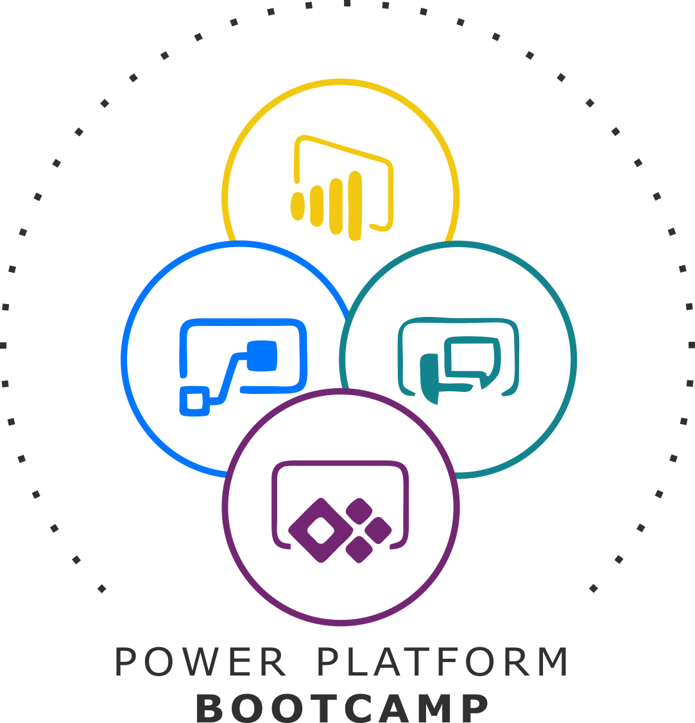


GLOBAL POWER PLATFORM BOOTCAMP
Organized Globally, Held Locally

Slide 2
Deep Dive to Power Virtual Agents
By : Saurabh Goyal

Slide 3




Who Am I ?
My Name is Saurabh Goyal
Certified Microsoft Professional (MCTS)
Working as Sr. Architect in Nagarro
Saurabh.goyal@nagarro.com
https://www.linkedin.com/in/saurabh-goyal-2636691b/
https://twitter.com/SaurabhNagarro

Slide 4


Session‘s Agenda
1
5
Introduction
Integrate
2
6
Administration
Monitoring
3
7
Manage Security
Community Support
4
8
Publish
DEMO : BOT Creation

Slide 5
Introduction

Slide 6
What are Chat Bots?
It’s a computer program
Designed to communicate with human users through the internet
It is artificial intelligence (AI) software
Simulates conversations with a user in natural language
Work independently from a human operator
Respond based on the knowledge database available to it at that point in time

Slide 7
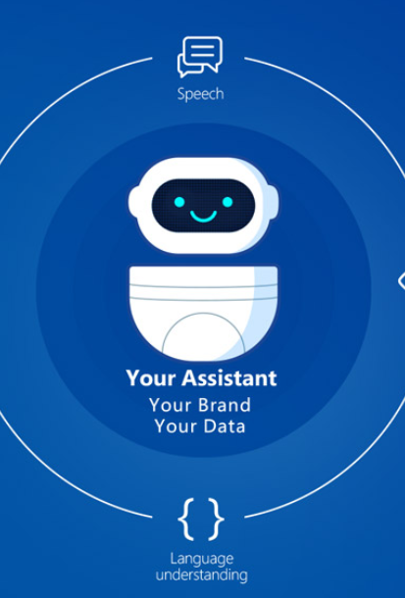
Chat bots can help, but….
Bots are hard to create
Lots of cost to maintain
Friction between subject matter experts with answer and the developers who create bots
Limited integration
No personal experience

Slide 8

What is Power Virtual Agent?
Software-as-a-service (SaaS) Offering
Create Powerful Bots
No Code Graphical Interface
Eliminates Gap between the SMEs and Development Team
Minimize IT Effort to deploy
Microsoft’s Powerful Conversational AI Capabilities
Offers Personalized Experiences
Reduce Costs
Measure Performance
Improve Customer Satisfaction
Limitless extensibility with Bot Framework Skills (Preview)

Slide 9
Administration

Slide 10
Administration
Need a license for each user / tenant
Pricing $1,000 for 2,000 sessions per tenant/month
Billing depends on number of sessions
Trial plans are available for 30 days
Create bots in different environments and switch between them
In order to have unlimited flow runs in Power Automate, you need to create a flow using the link from within the Power Virtual Agents app
Flow runs created using this template do not accrue to your overall Power Automate quotas

Slide 11
Author & Edit

Slide 12



Building Blocks
Entities
Authoring
canvas
Topics

Slide 13
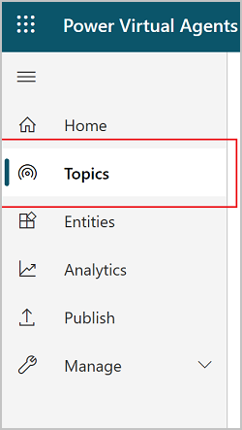
Topics
Some use case specific content
Defines a how a bot conversation plays out
Has trigger phrases
List of predefined topics is available
Two Types of Topics
User Topics
System Topics
Add a new topic

Slide 14
Entities
Ability for the AI to understand a user's intent
Fundamental aspect of natural language understanding is to identify entities
Prebuilt entities
Custom entities
Smart matching
Synonyms
Use entities in a conversation

Slide 15
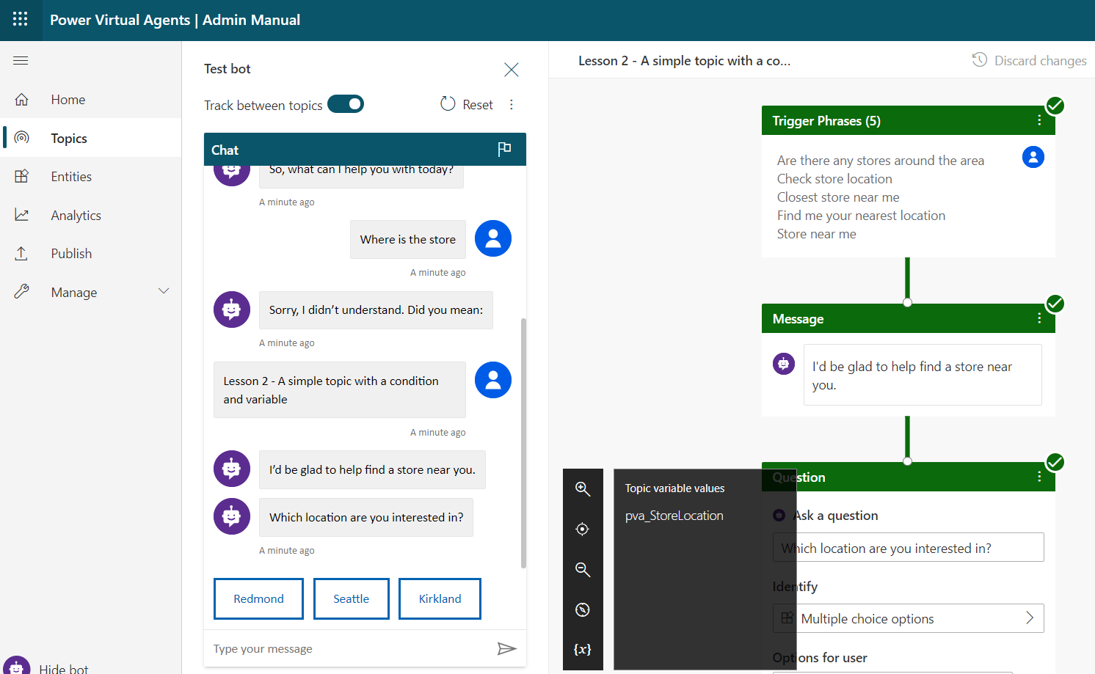
Authoring Canvas
Place for designing flow of the chatbot
This is per topic
Extract information form user responses
Variables
Add nodes
Remember user response
Start an action
Notes:
Test you bot

Slide 16
Security : End User Auth.

Slide 17
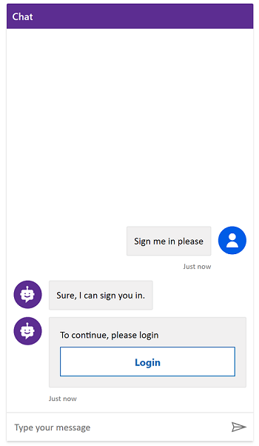
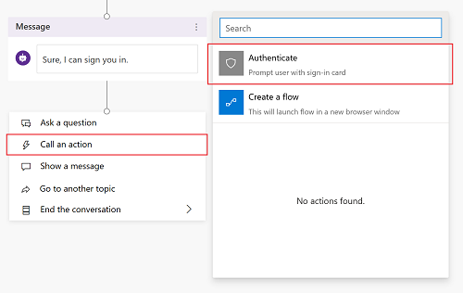
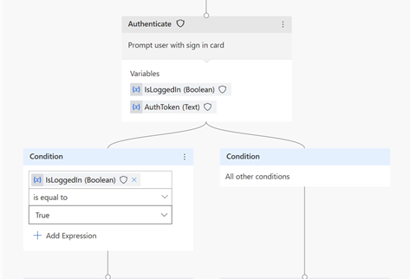
Authentication to Power Virtual Agents
The Authenticate node is where the user, if not already signed in, will be prompted with a sign-in card.
IsLoggedIn & AuthToken are two output variables

Slide 18
Publish & Integrate

Slide 19
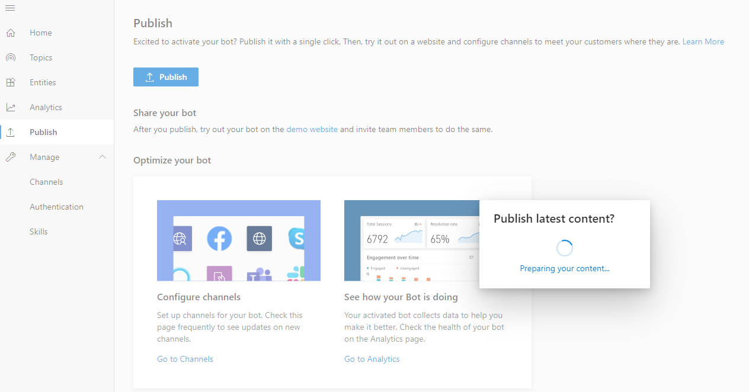
Publish your bot
Publish the bot at least once
Prebuilt Demo website
Useful to gather feedback from stakeholders
Link will open a new tab
Useful for testing with a limited set of users
Edit the welcome message and suggested trigger phrases for the demo website
Share the demo website link
Add your bot to custom websites as IFrame.

Slide 20
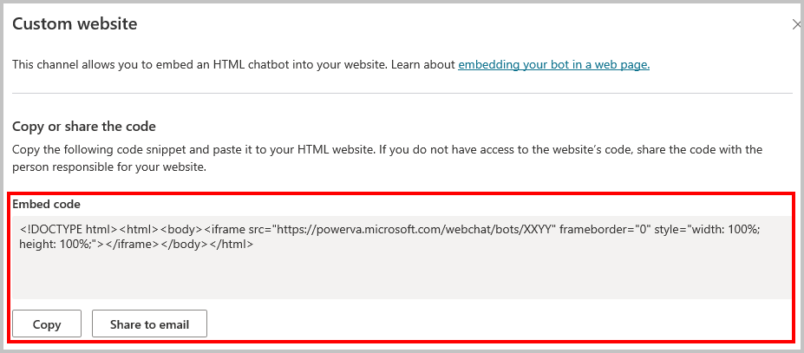
Integrate
Add Bot to Live website as IFrame
Channels
Custom Website
SharePoint
MS Teams
Facebook
Yammer
Mobile App
PowerApps Portal
Cortana, etc.

Slide 21
Monitoring

Slide 22
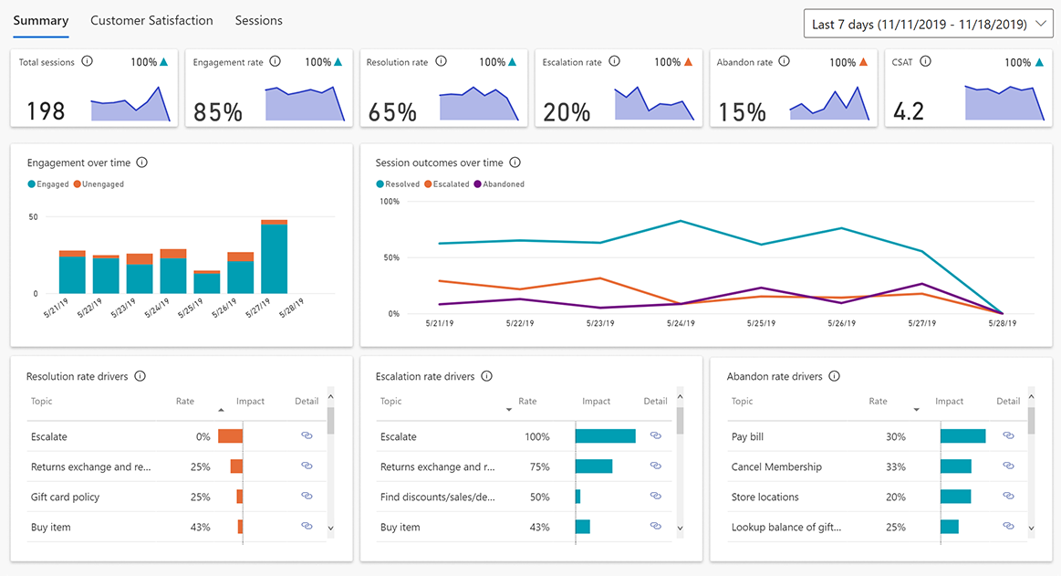
Monitor & Diagnose
Total Sessions
Engagement rate
Resolution rate
Escalation rate
Abandon rate
CSAT
Engagement over time
Session outcomes over time
Resolution rate drivers
Escalation rate drivers
Abandon rate drivers

Slide 23
Community & Support

Slide 24
Community & Support
Ask the community
Visit the Power Virtual Agents community to get answers and tips directly from other Power Virtual Agents users.
Submit an idea
Do you have a great idea that will make Power Virtual Agents even better? MS love to hear from you!
Microsoft Support
If you're an administrator of your Power Virtual Agents tenant, you can use the Power Platform Admin Center to request support from Microsoft.

Slide 25
Limits & Boundaries
Cannot export the virtual agents
Deployment methodology from one environment to another
You can have up to 1000 topics in a bot
Not supported in Internet Explorer.
Use the latest versions of Microsoft Edge, Chrome, or Firefox
Power Virtual Agents does not currently support US Government Cloud plans.

Slide 26
Creation of Bot

Slide 27
Any Questions?

Slide 28
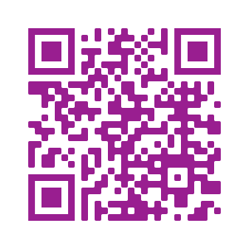
Please fill out the survey! & Win Swags!!
https://www.powerplatformbootcamp.com/survey

Slide 29
Thank You For Attending

